Slide 1
Task Tracker App
React Web Application Presentation
Adrián Flores

Slide 2
Introduction
Project: Task Tracker App
Built with: React, React Router, Context API, localStorage
Goal: Create a functional task management system
Focus: Usability, component reuse, data persistence

Slide 3
Main Features
✅ Add, edit, delete tasks
✅ Mark tasks as completed or pending
✅ Filter by status (All, Completed, Pending)
✅ Persistent storage with localStorage
✅ Responsive design and form validation

Slide 4
Project Structure
components/ - Reusable UI components (TaskCard, TaskForm, etc.)
pages/ - Route pages (Dashboard, AddTask, EditTask)
context/ - Global state using Context API
App.jsx - Main routes and layout
styles.css - Custom styling

Slide 5
State Management
React Hooks: useState, useEffect
Context API: manage tasks globally
Form inputs are controlled components
Task data stored in localStorage

Slide 6
Routing & Navigation
React Router DOM used for SPA routing
Routes: '/', '/add-task', '/task/:id'
Navigation via Navbar component
useNavigate used for programmatic routing

Slide 7
Demo Workflow
1. View all tasks on Dashboard
2. Add new task via form
3. Edit task from task card
4. Mark as complete or delete
5. Filter tasks using status buttons

Slide 8
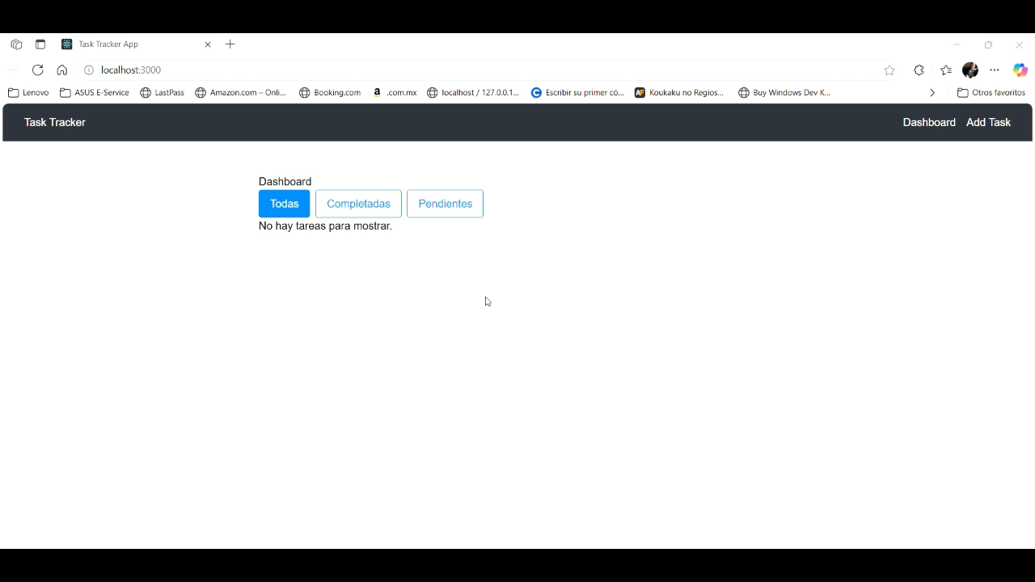
App Working

Slide 9
Conclusion
Learned React fundamentals and state management
Built reusable and maintainable components
Implemented responsive UI with validation
Handled real-time updates with Hooks and Context
Persisted data using browser localStorage

